Slide 1
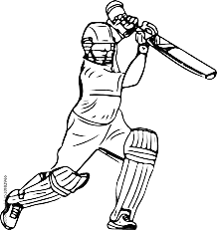
World Cup T-20
TEAM :- T-20 wizard

Slide 2

AGENDA
Problem statement
Overview
Solution
Result

Slide 3
PROBLEM STATEMENT
Many people like Dream 11 users, Students, business owners and ‘Satta Bazar’ user having players data issues . In our project are providing different kind of players data for these people mostly don’t aware about it.

Slide 4
PROJECT OVERVIEW
The project aims to explore performance trends, strategic of individual players and strength of team.
Collecting and Filtering data, like who is best player in the team and country.

Slide 5
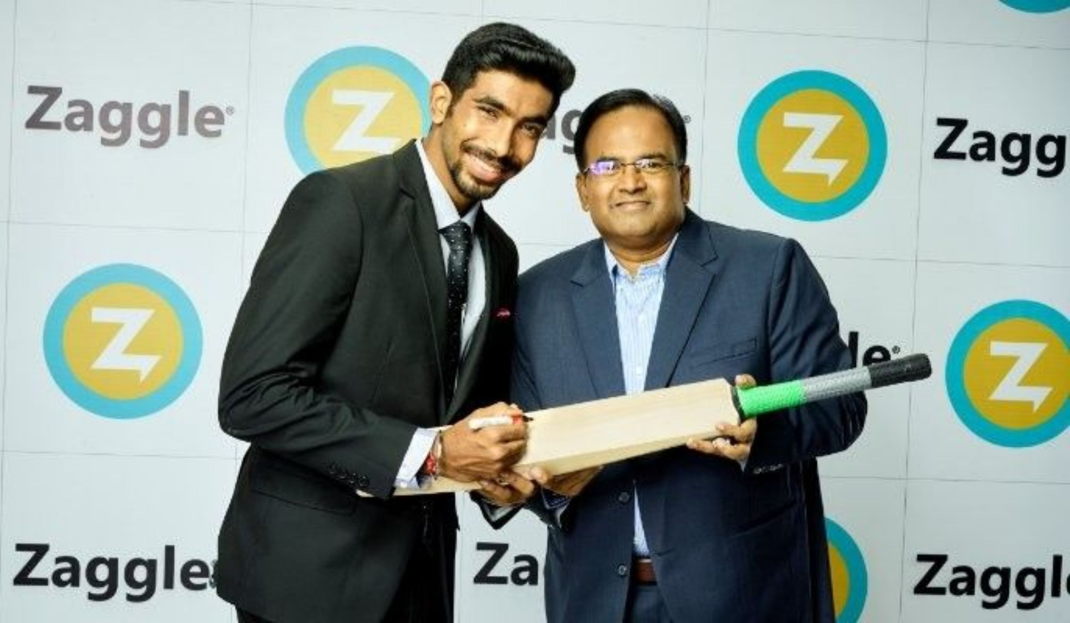
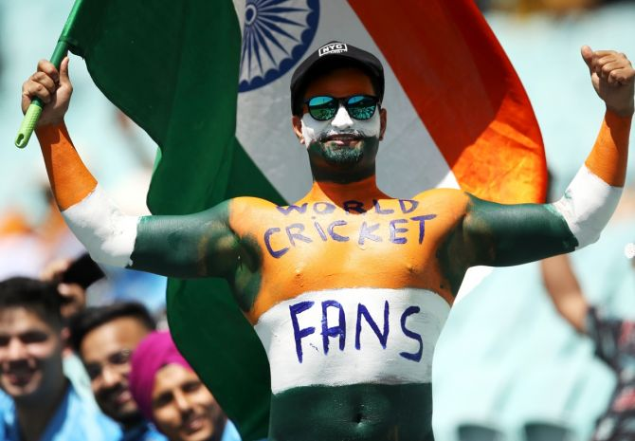
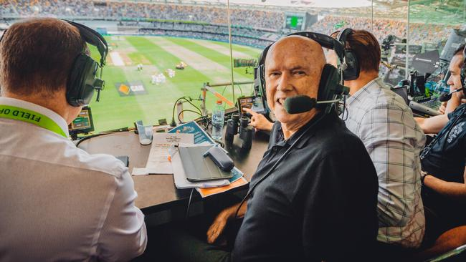
WHO ARE THE END USERS?
Students
Cricket Legends
Cricket Fans
Business owners
Cricket Analysts and Commentators

Slide 6
YOUR SOLUTION AND ITS VALUE PROPOSITION
THIS PROJECT CAN GIVE INFORMATION ABOUT THE PLAYERS IN THE WORD ON THE BASIS OF MAJOR THREE CATOGITRY ALL ROUNDERS, BOWLER AND BATSMAN.
THE PROJECT ADDS TO THE COLLECTIVE KNOWLEDGE OF T-20 CRICKET, POTENTIALLY INFLUENCING FUTURE STATEGIES AND CONTRIBUTING TO GROWTH OF THE SPORTS.

Slide 7
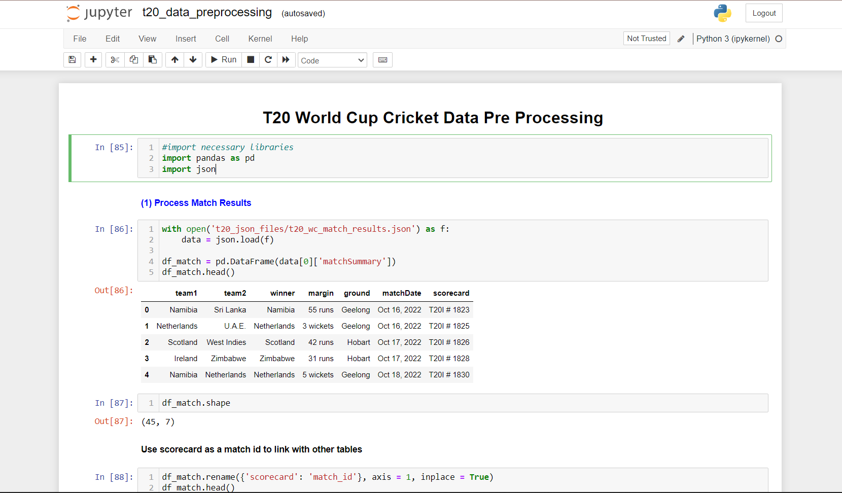
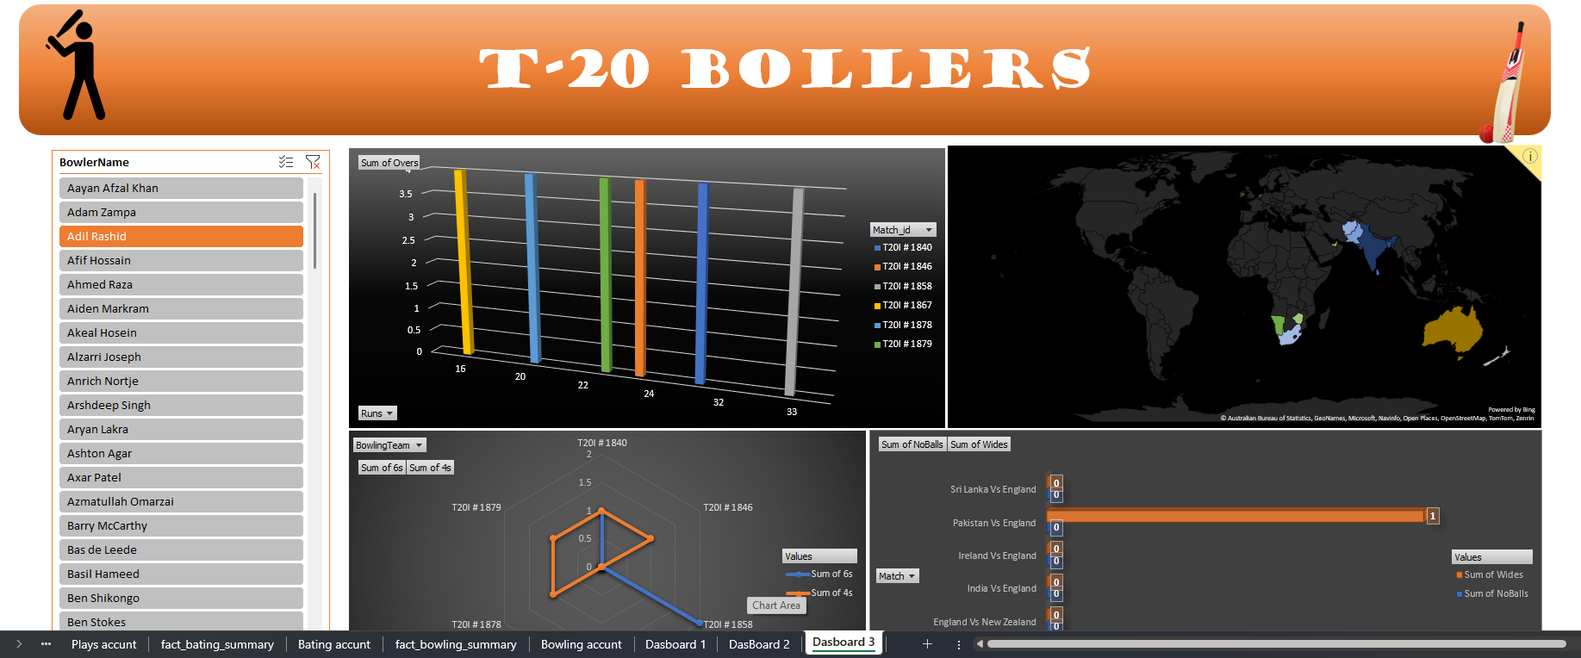
RESULTS

Slide 8
MEET OUR TEAM
AMAN HATWAR
MD GAFFAR
ANURAG KUMAR
RAJIV KUMAR

Slide 9

Thank You all

